Slide 1

Analysis on Stock Market Data of Bosch
Team 4
SASHANTH A
BHARATH
SARTAK
ERIC

Slide 2
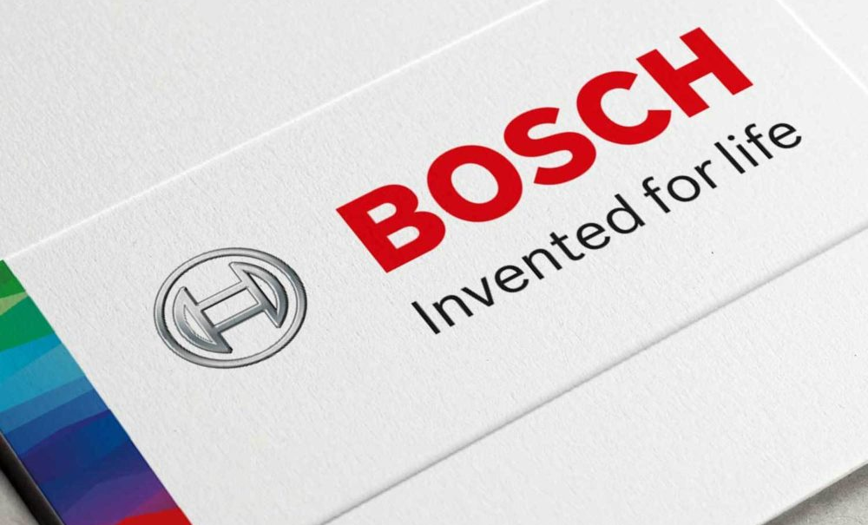

HISTORY OF THE COMPANY
Robert Bosch was born on September 23, 1861, in Albeck near Ulm.
In 1886, “Workshop for Precision Mechanics and Electrical Engineering” in Stuttgart. This was the birth of today’s globally operating company.
Global steps 1906-1925, 1912 Bosch started manufacturing its star product in Springfield, Massachusetts.
1926 -1945 was an era for cars in bosch, the first diesel-injection pump for cars went to market in 1936.
Reconstruction 1946-1959(was a black era) By 1945, more than 50 percent of the Bosch plant facilities in Germany had been destroyed by Allied bombs.
New business 1960 -1989(transformation era) Bosch, turning it into a diversified group ,a global company, and the market leader in automotive electronics.
1990(Globalization era)
Never forget your humanity, and respect human dignity in your dealings with others.

Slide 3
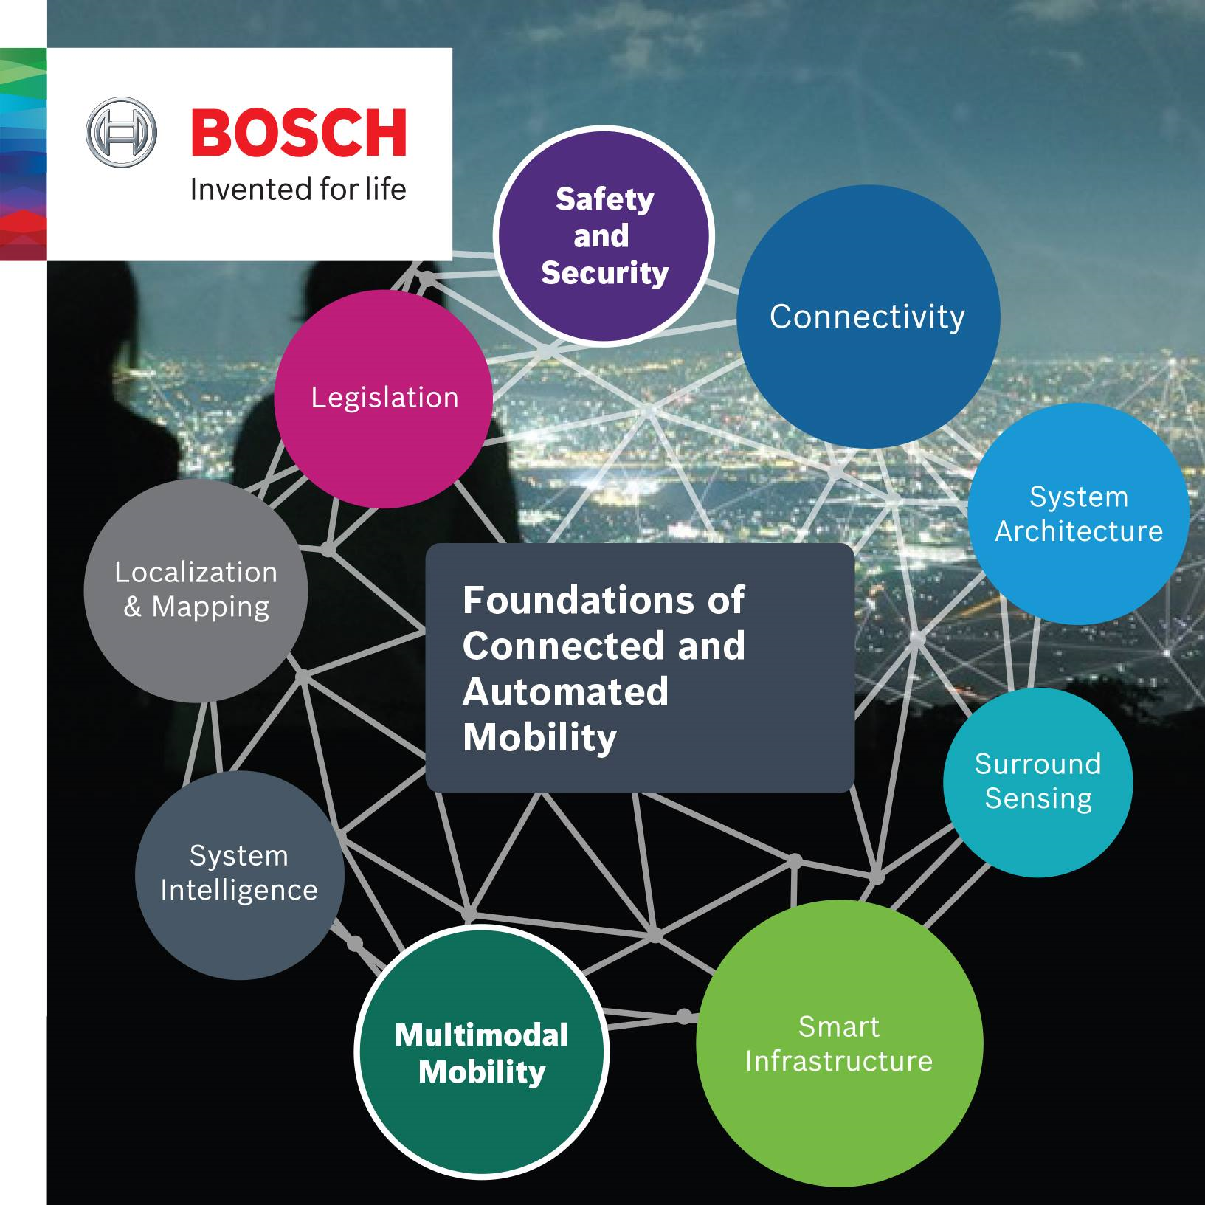
ABOUT BOSCH
Bosch, German multinational engineering and technology company headquartered in Gerlingen. The company was founded by Robert Bosch in Stuttgart in 1886.
Bosch's core operating areas are spread across four business sectors:
Mobility (hardware and software). (61% of world share)
Consumer goods (including household appliances and power tools).(39%)
Industrial technology (including drive and control)
Energy and Building technology.

Slide 4
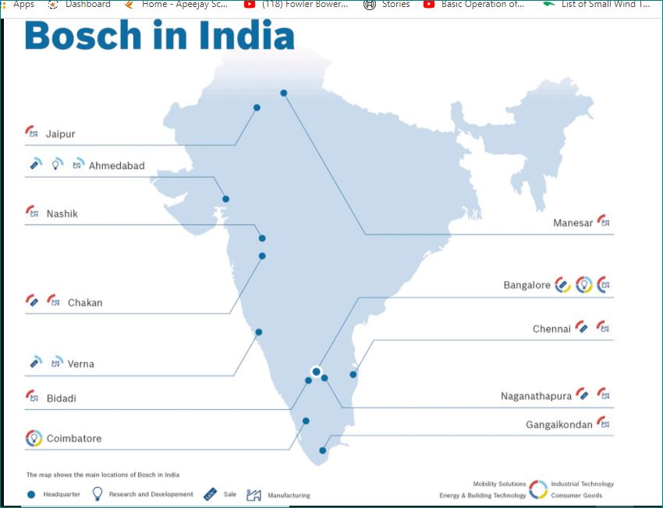
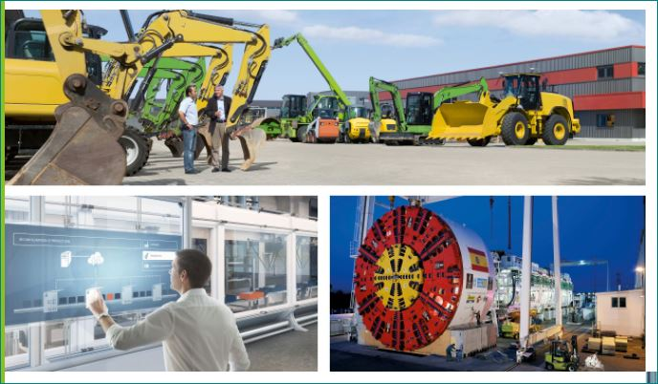

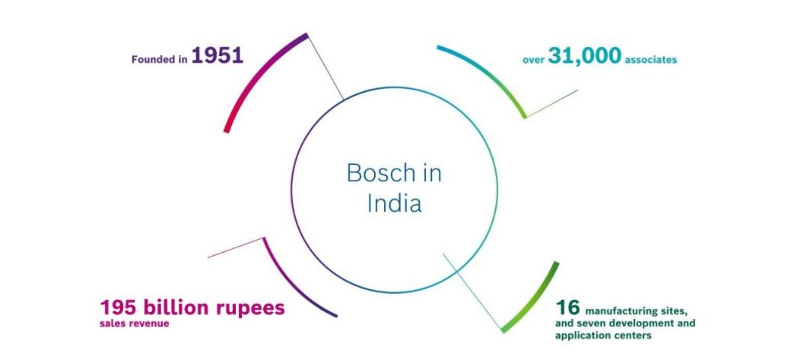

Slide 5
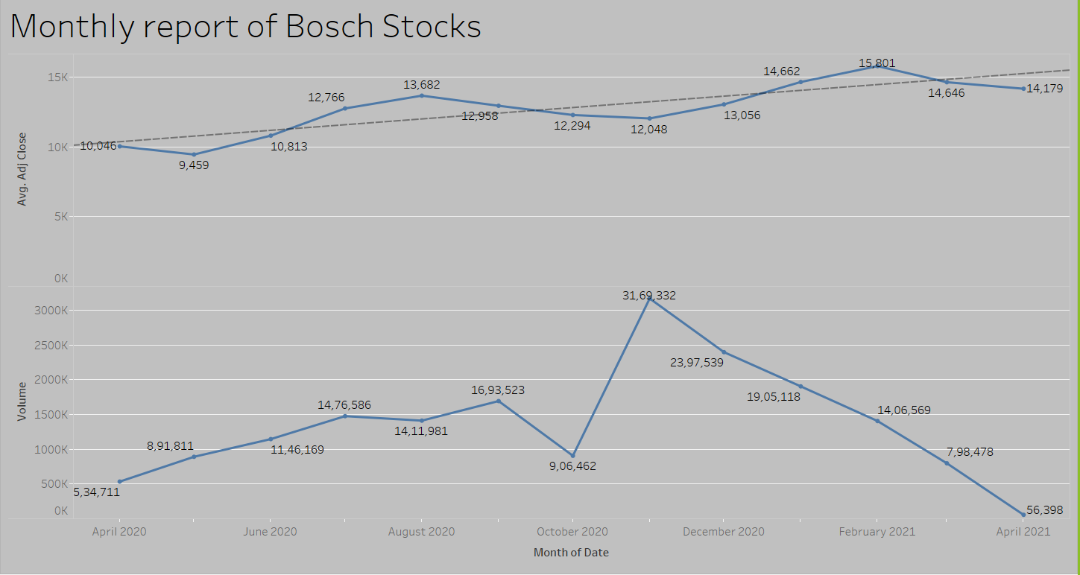

Slide 6
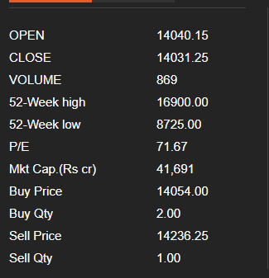
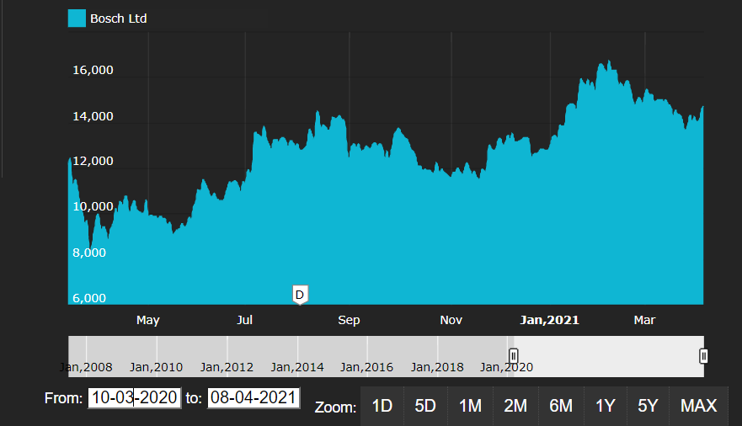
Overview as on 6th April 2021

Slide 7
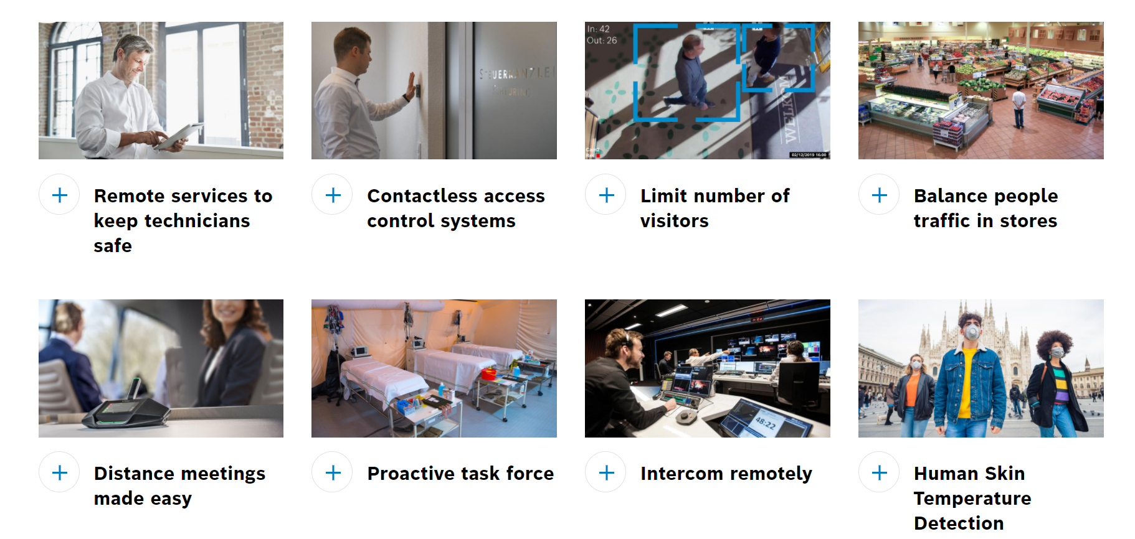
BOSCH AGAINST COVID

Slide 8
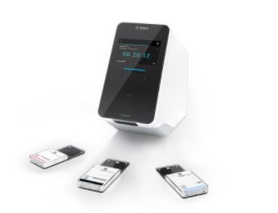

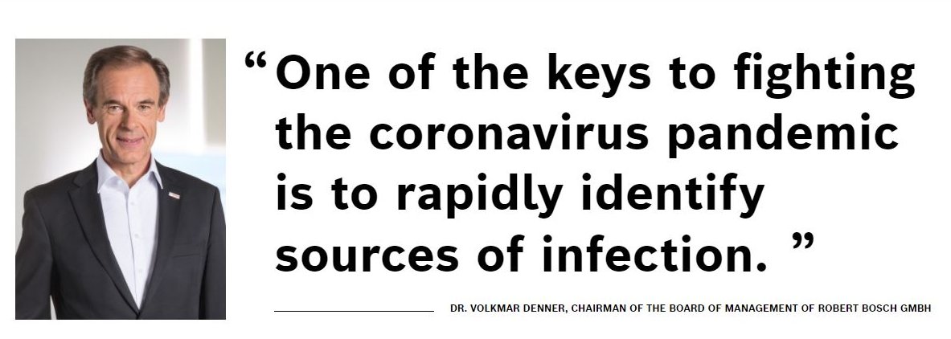
A world first: simultaneous
testing of five samples
Bosch has developed a new rapid test for its Vivalytic analysis device to detect the SARS-CoV-2 pathogen. The test provides a reliable result in 39 minutes and is currently the fastest polymerase chain reaction (PCR) test worldwide. Results for positive samples are even delivered in less than 30 minutes.

Slide 9
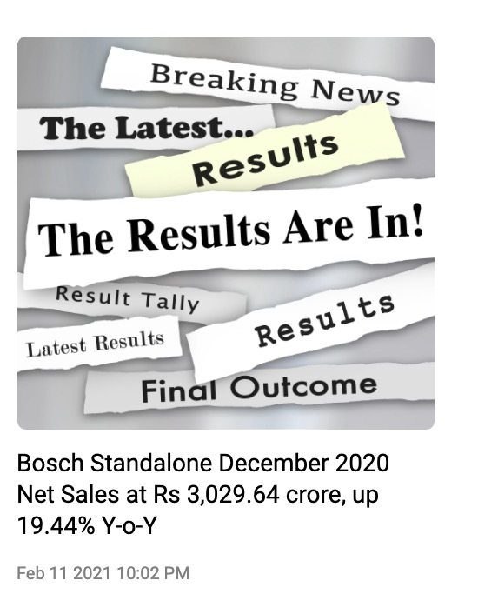
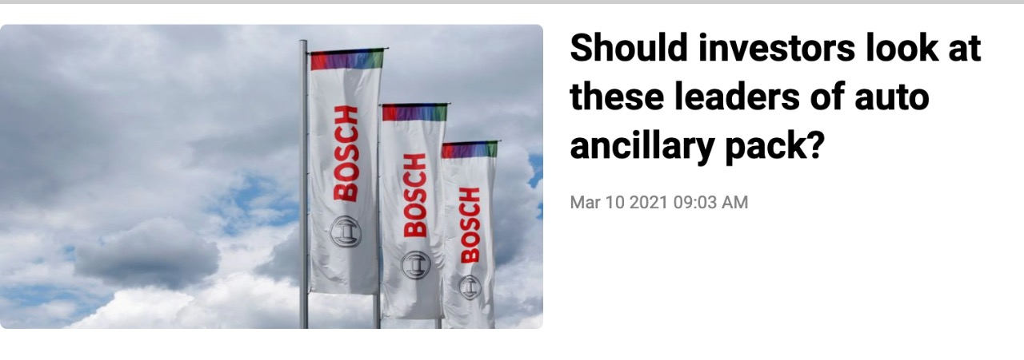
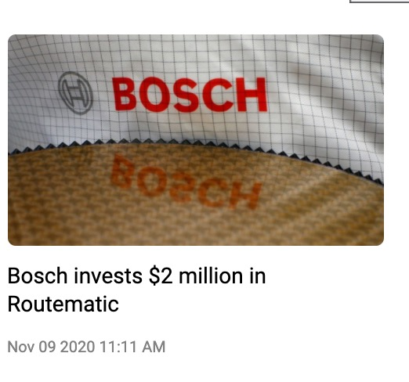
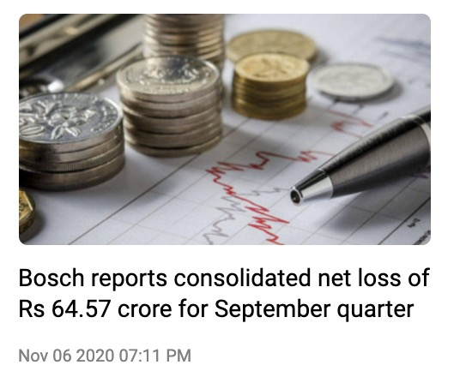

Slide 10
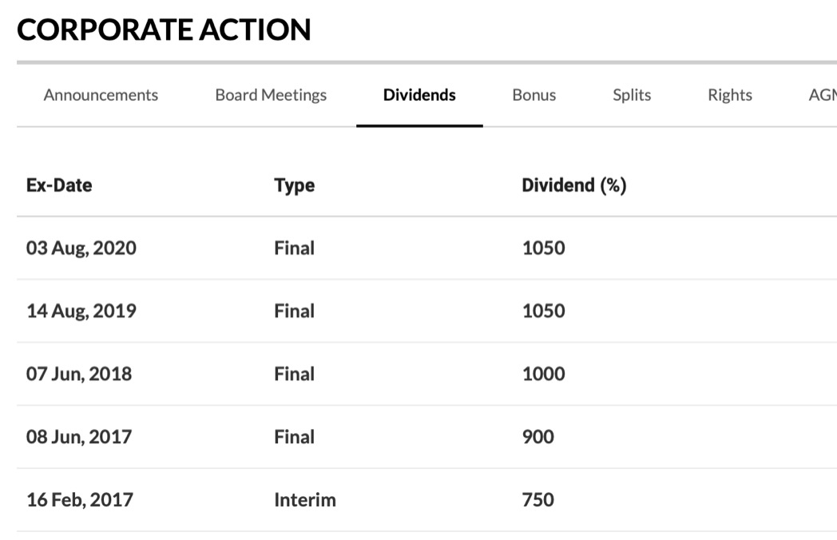
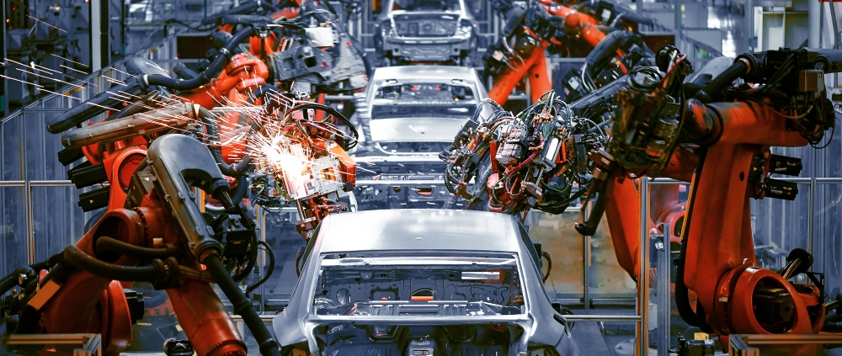
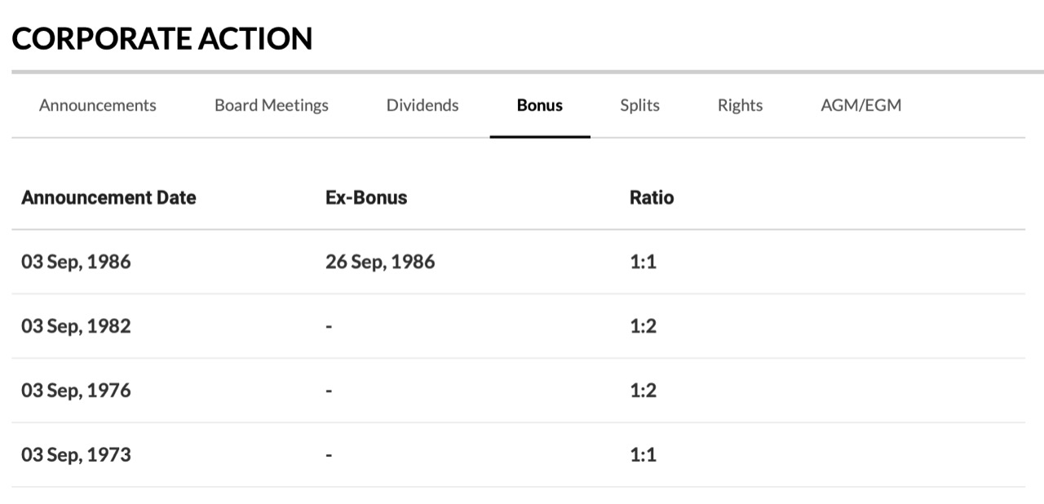
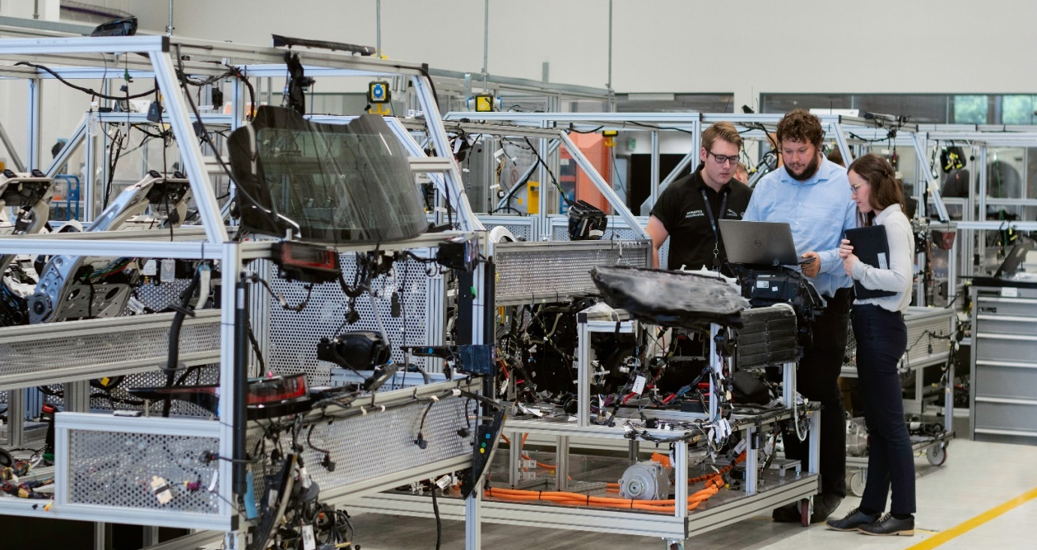

Slide 11
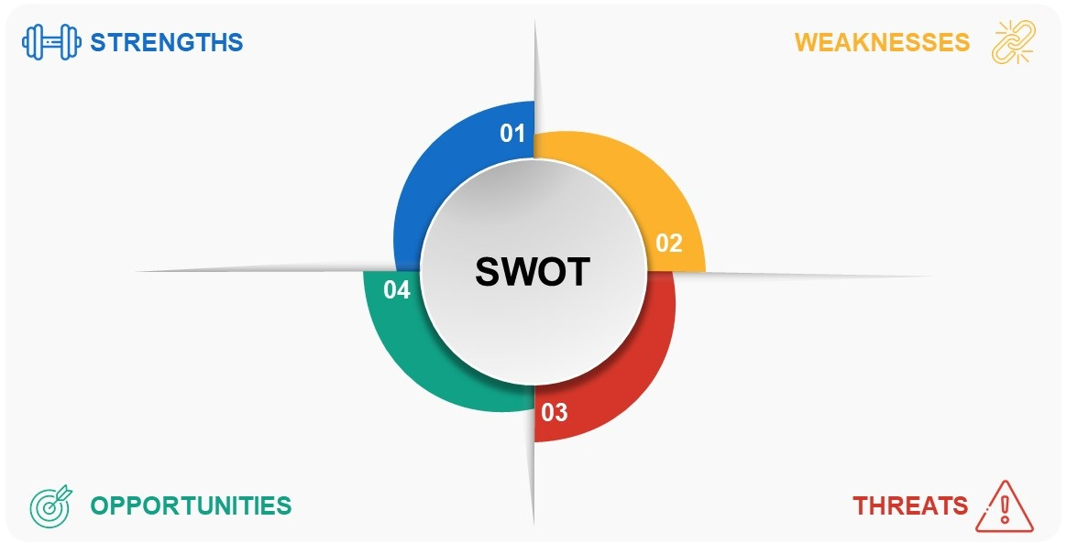
Profitability ratio is below the industry average
Limited success outside core business
Dependent on single segment
Frequent product recall
Strong Brand Portfolio
Geographic diversification
Focus on innovation and R&D
Quality of products-customer loyalty
Growth in global automotive industry
Strong presence in Newly Emerging Markets
Adapting to emerging technologies like AI and IoT.
Hybrid car components and Renewable energy sector
Intense competition
Increase in trade protection policies.
Impact of global economy on automobile industry
Fuel pricing and currency fluctuation

Slide 12
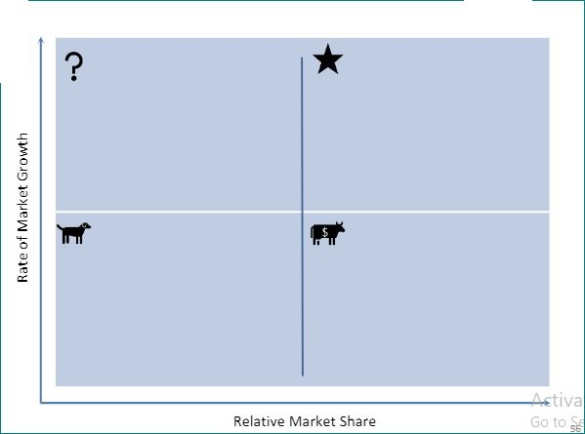
The local foods business unit
The confectionery
Bosch Wiring assembly
Mobility Solutions
The financial services
business
Bosch Battery and Spark plug
BCG
MATRIX
The plastic bags, synthetic fibers
The artificially flavored products
Bosch Generator
The supplier service
business unit
Bosch Fuel Injector, Power tool

Slide 13
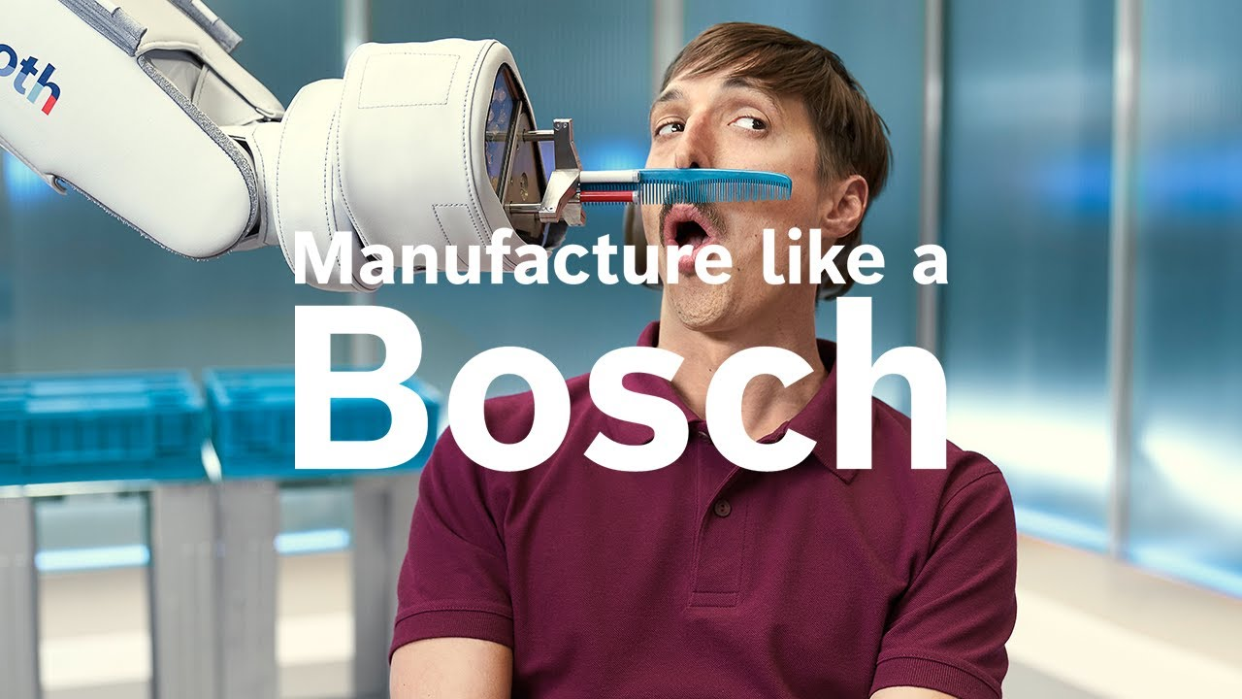
Thank You

